Slide 1
Movie Rating Prediction with python

Slide 2


Introduction to Movie Rating Prediction
Movie rating prediction is a fascinating application of machine learning and data science. It involves predicting the ratings that users will give to movies, based on various factors such as user preferences, movie genres, and historical data. This task is essential for recommendation systems, which suggest movies to users on platforms like Netflix, Amazon Prime, or IMDb.

Slide 3



Importance of Predicting Movie Ratings
Accurately predicting movie ratings is crucial for various stakeholders. Movie studios can use it to understand audience preferences and make informed decisions about marketing and distribution. Streaming platforms can enhance their recommendation systems to provide users with more personalized content. Moreover, understanding viewer preferences can lead to the development of more engaging and impactful films.
Enhanced Recommendations
Improved Marketing Strategies
Users can receive more tailored suggestions based on their past preferences, leading to a more personalized and enjoyable experience.
Studios can target specific audiences with greater accuracy, optimizing marketing campaigns and maximizing reach.
Data-Driven Filmmaking
Filmmakers can analyze audience data to identify popular themes and genres, potentially influencing their creative decisions.

Slide 4


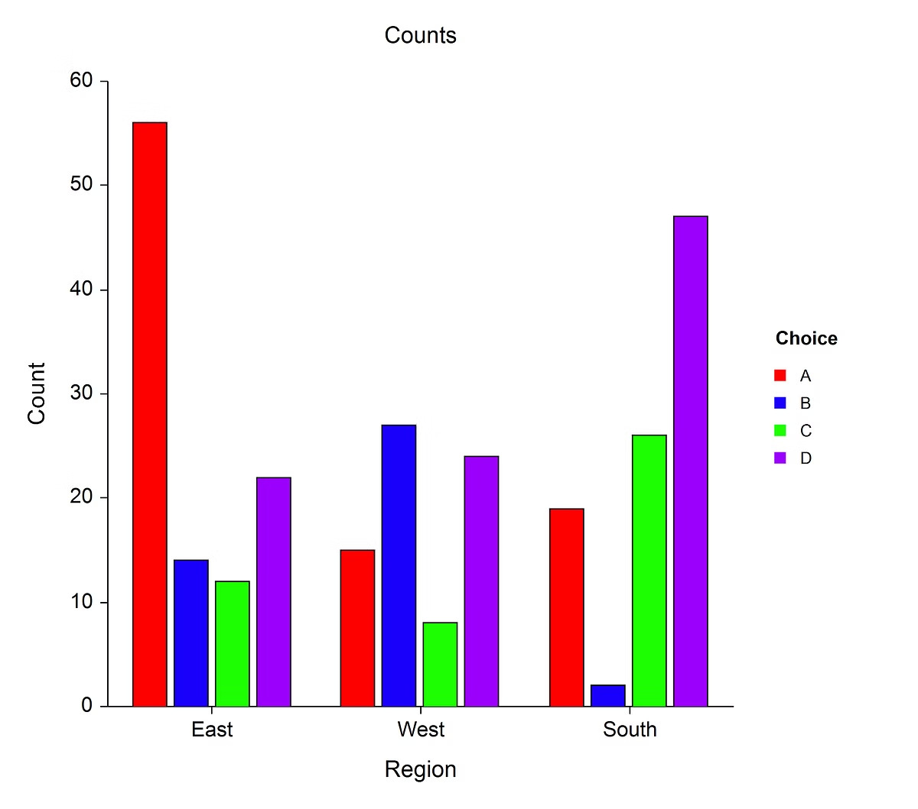

Data Collection and Preprocessing
The first step in movie rating prediction is gathering relevant data. This can include information about the movie itself, such as genre, actors, director, and release date. We can also collect user-generated data like ratings, reviews, and social media sentiment. Once data is collected, it needs to be cleaned and formatted for analysis. This involves handling missing values, converting text data into numerical formats, and removing irrelevant information.
1
Data Gathering
Collect data from various sources, such as movie databases, online reviews, and social media platforms.
2
Data Cleaning
Remove duplicates, handle missing values, and address inconsistencies in data formatting.
3
Feature Engineering
Transform raw data into meaningful features that can be used for prediction.
4
Data Transformation
Convert text data into numerical formats and normalize data scales to ensure consistency.

Slide 5


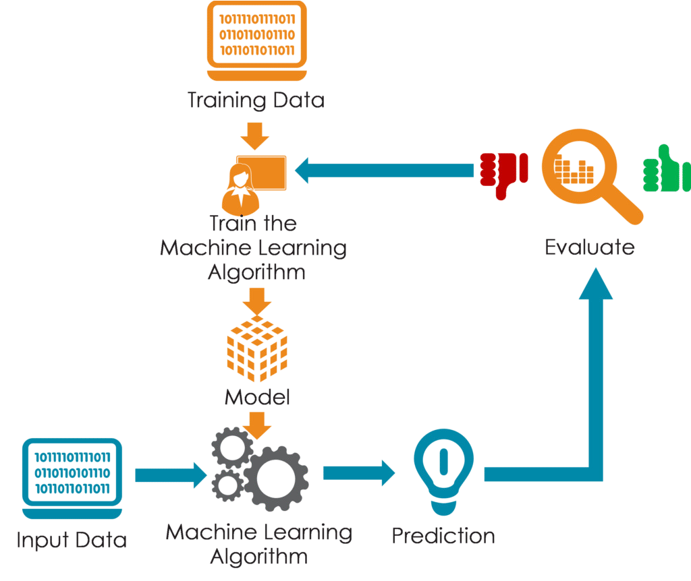
Feature Engineering
Feature engineering is a crucial step in transforming raw data into meaningful features that can be used by machine learning models. This involves extracting relevant information from existing data and creating new features. For instance, we can create features that represent the popularity of actors, the genre diversity of a movie, or the sentiment of online reviews.
1
Categorical Features
2
Numerical Features
Convert text categories, such as genre and actors, into numerical representations using techniques like one- hot encoding.
Extract numerical features from data, such as release date, runtime, and budget.
3
Derived Features
Create new features by combining existing information, such as the average rating of a director's previous films.
4
Text Features
Use natural language processing techniques to extract sentiment and key themes from reviews and summaries.

Slide 6
Exploratory Data Analysis
Exploratory Data Analysis (EDA) is essential to understand the relationships within the data. Visualization techniques help identify patterns, trends, and outliers, providing valuable insights for model development. This step can also help identify potential biases or inconsistencies in the data, allowing for adjustments before model training.
Data Distribution
Correlations
Outlier Detection
Visualize the distribution of ratings and other features using histograms and boxplots.
Identify and analyze outliers that may impact model performance.
Explore the relationships between features using scatter plots and correlation. matrices.

Slide 7


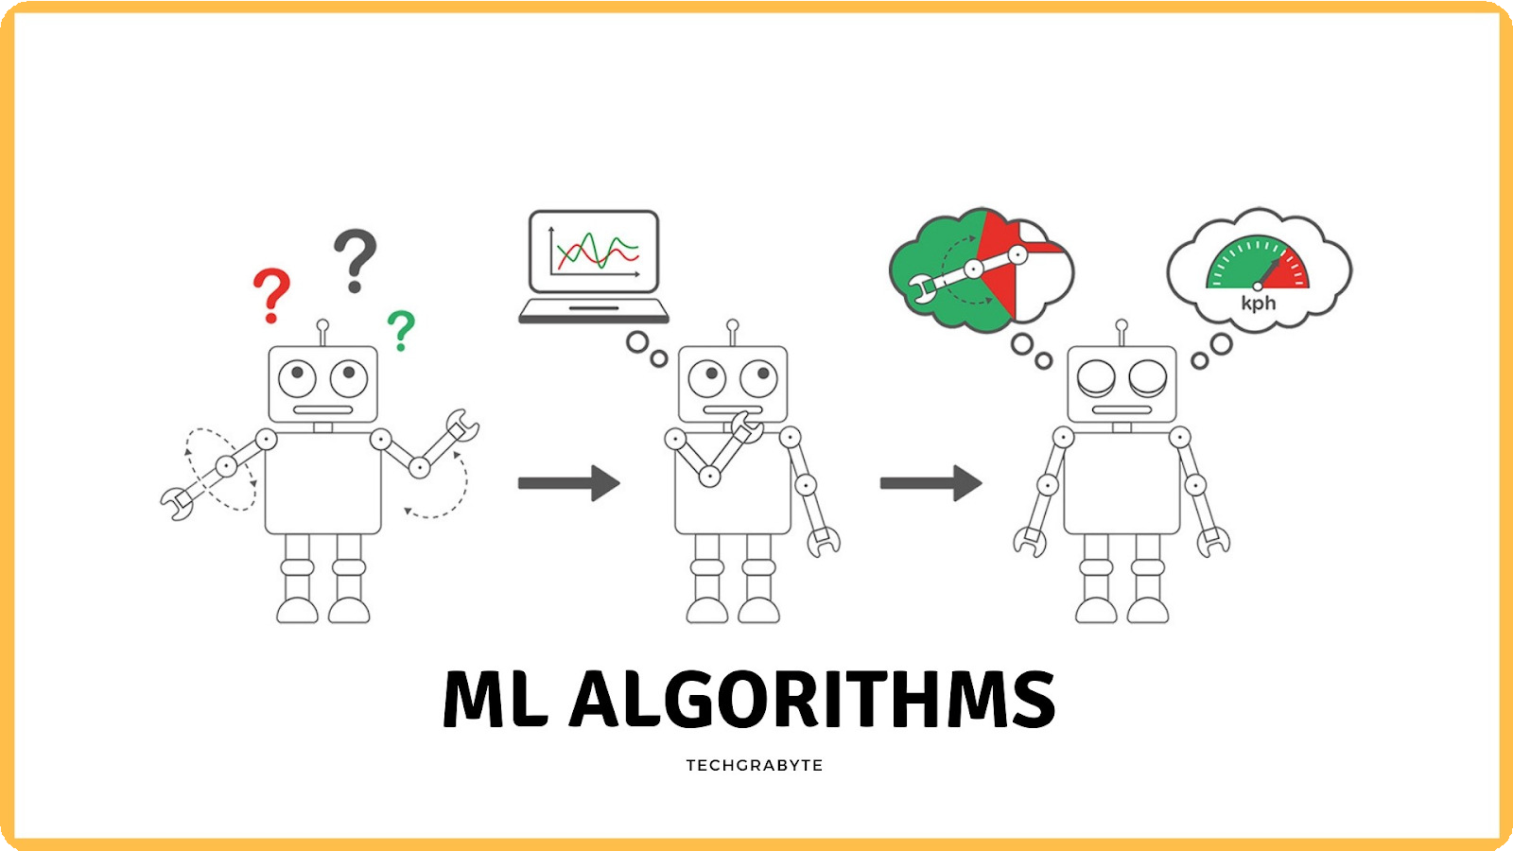
Model Selection and Training
Model selection is crucial for movie rating prediction. Various algorithms can be used, including linear regression, decision trees, and neural networks. Choosing the right model depends on the complexity of the data, the desired accuracy, and the computational resources available. Once the model is selected, it needs to be trained using the prepared data. This involves adjusting the model's parameters to minimize the error between predicted ratings and actual ratings.
Linear Regression
1
Predicts ratings based on a linear relationship with features.
Decision Trees
2
Creates a tree-like structure to make decisions based on features.
Neural Networks
3
Uses interconnected nodes to learn complex relationships between features and ratings.

Slide 8



Model Deployment
Once the model is trained and evaluated, it needs to be deployed to make predictions in a real-world setting. This involves integrating the model with existing systems or creating a new application that leverages the model's capabilities.
Web Application
Develop a web application that allows users to input movie information and receive predictions.
Mobile App
Create a mobile application that provides personalized movie recommendations based on user preferences.
Streaming Service Integration
Integrate the model with a streaming platform to improve its recommendation engine.

Slide 9


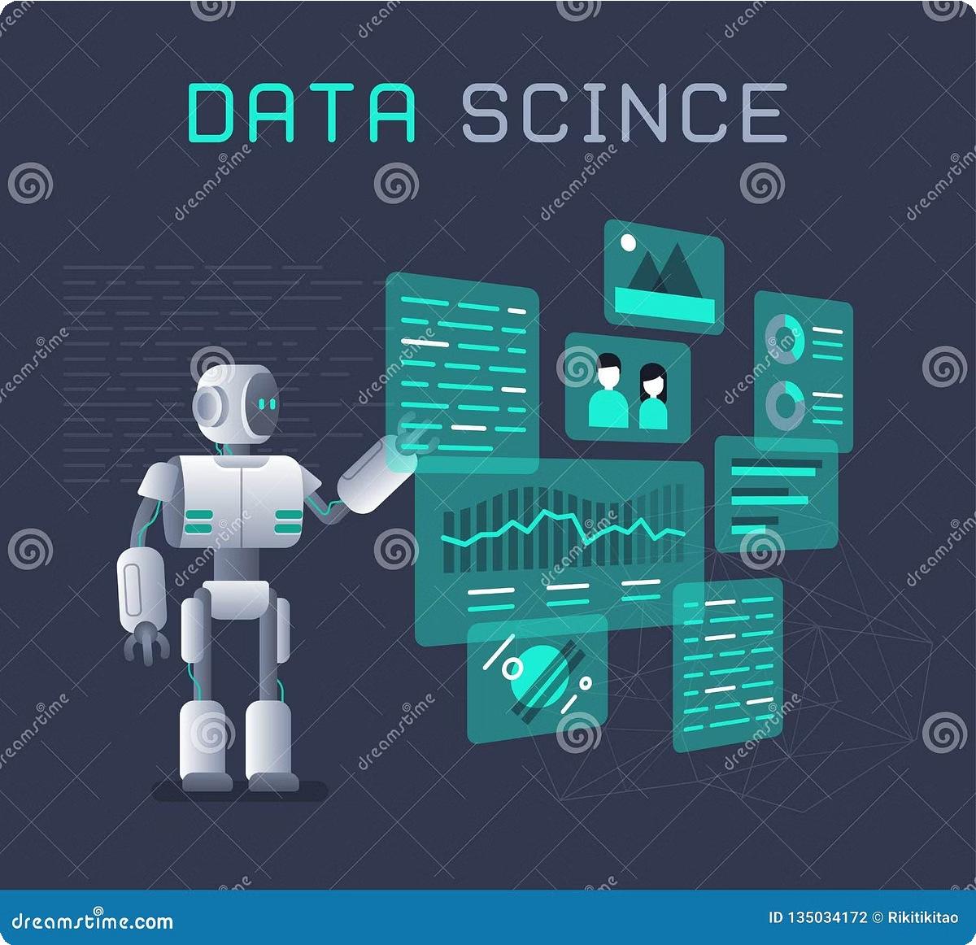
Conclusion and Future Improvements
Predicting movie ratings is a complex but rewarding task. Using Python, we can build models that provide valuable insights into audience preferences, improve content recommendations, and influence creative decisions in the entertainment industry. Future improvements can involve incorporating more sophisticated machine learning algorithms, exploring alternative data sources, and developing more robust evaluation metrics.
Advanced Algorithms
Multimodal Data
Experiment with newer and more complex algorithms to enhance prediction accuracy.
Integrate various data modalities, such as images, audio, and text, for a richer understanding of movies.
Real-Time Predictions
Develop models that can provide accurate predictions in real-time, responding to dynamic user preferences.

Slide 10
Thank you

